Slide 1

Intersection Traffic Automation for Vehicles
Avery Belanger, William Valentine, Jie Zhao

Slide 2
Presentation Outline
Introduction
Assembling the car
Motors
Server
Methods
Design of the Server and Car
The Re-creation of an Intersection Scene
YOLOv8
Car Identification
Car and Pedestrian Queuing
Results
Demo
Future work

Slide 3

What is Computer Vision
Source: Narc — A Fault Detecting Solution, Medium

Slide 4
What is Computer Vision
Two main parts of our studies
Image recognition
Object detection
Image recognition
You look at an image of fruit and recognize an orange in the image
Object detection
You look at an image of fruit and determine where an orange is

Slide 5
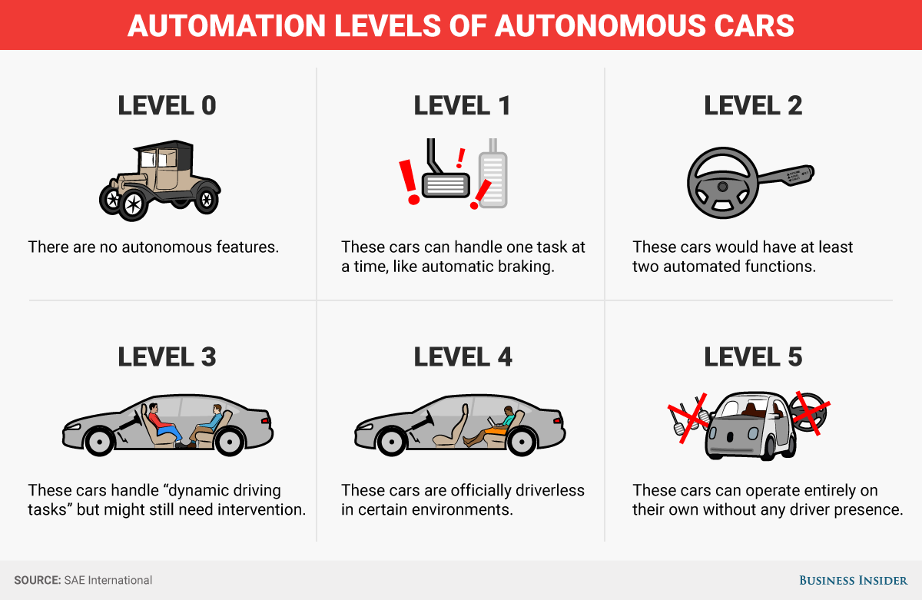
What are Autonomous Vehicles
Source: Business Insider

Slide 6
What are Autonomous Vehicles
The components of autonomous vehicles can be broken down into two categories.
Hardware
Traditional automotive parts (engine, brakes, and wheels)
Sensors (LiDAR, Radar, and Cameras)
On-board computers (for analyzing complex information in real-time)
Software
Network communication
Computer vision
Path planning

Slide 7
Research Motivation (Why this matters)
Self-driving cars are expensive ($70,000-$150,000, Reuters)
Intersection traffic is often an issue because people do not want to wait at intersections
Intersections often cause the highest number of accidents on roadways (>50%, Federal Highway Administration)

Slide 8
Our Research Goal
To mitigate the issues caused by intersections, we purpose creating a centralized control system of remote-controlled cars, to see if a real-world implementation of sensor-less vehicles for intersection automation is feasible.

Slide 9
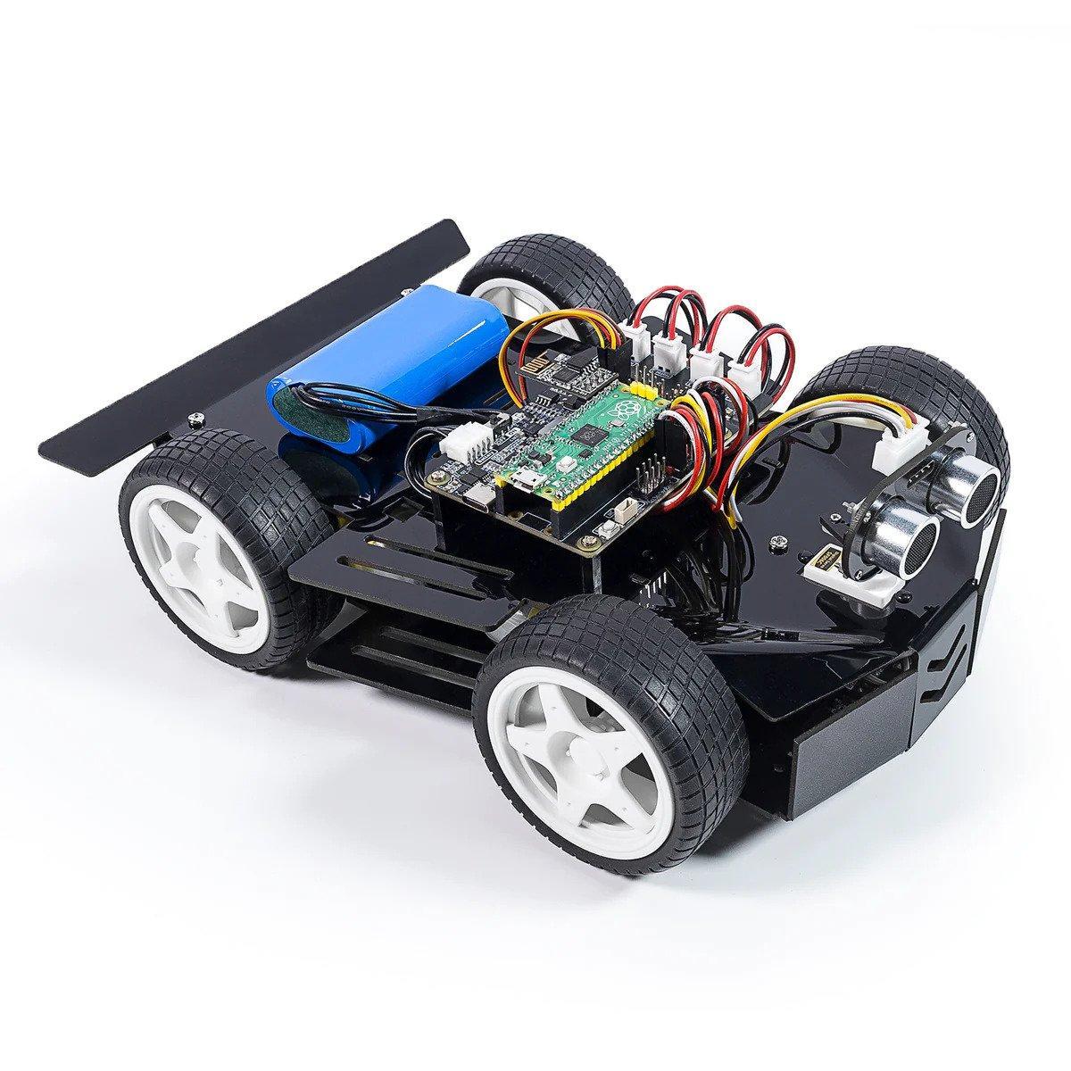
Assembly of the Car
Raspberry Pi Pico (running micropython)
PICO RDP (Robotic Development Platform)
ESP8266 ESP01s (WiFi module)
Battery
Four individual motors
Radar sensor
Servo (for radar sensor)
Speed sensor
Grayscale sensor
Source: Raspberry Pi Pico 4wd car, SunFounder

Slide 10
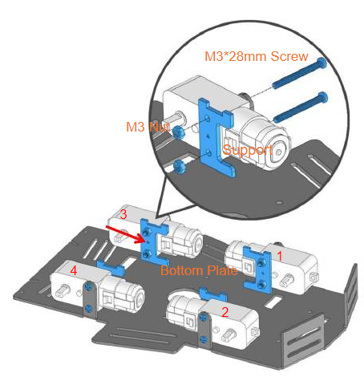
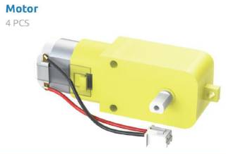
Motors
Source: Sunfounder-Picar-4wd, Manualslib

Slide 11
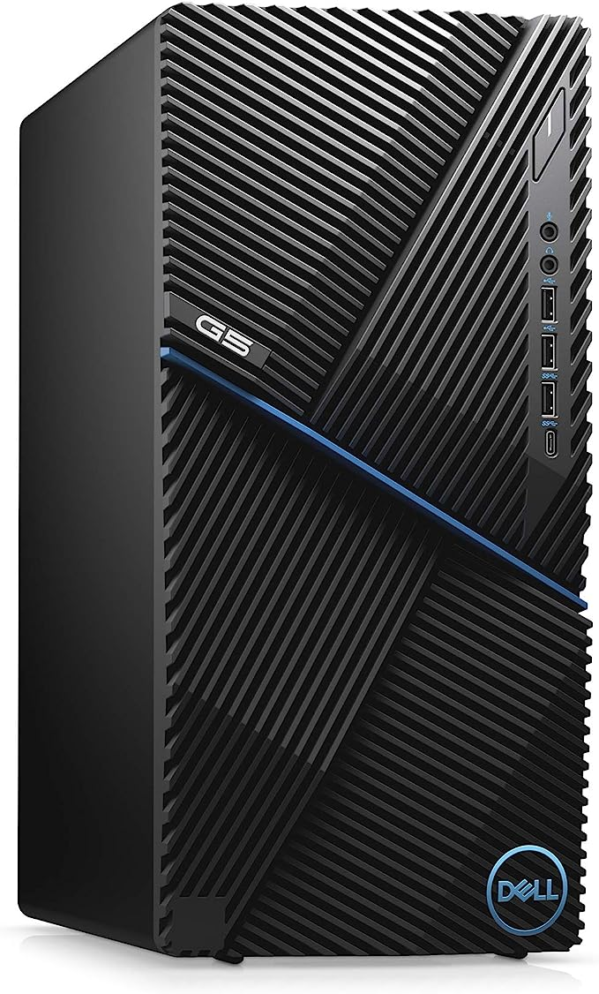
Server Specifications
CPU: Intel i7-10700F @ 2.9GHz
Memory: 16GB
SSD: 512GB
OS: Windows 10
GPU: GeForce GTX 1660 Ti
Source: Dell G5 Gaming Desktop, Amazon.com

Slide 12
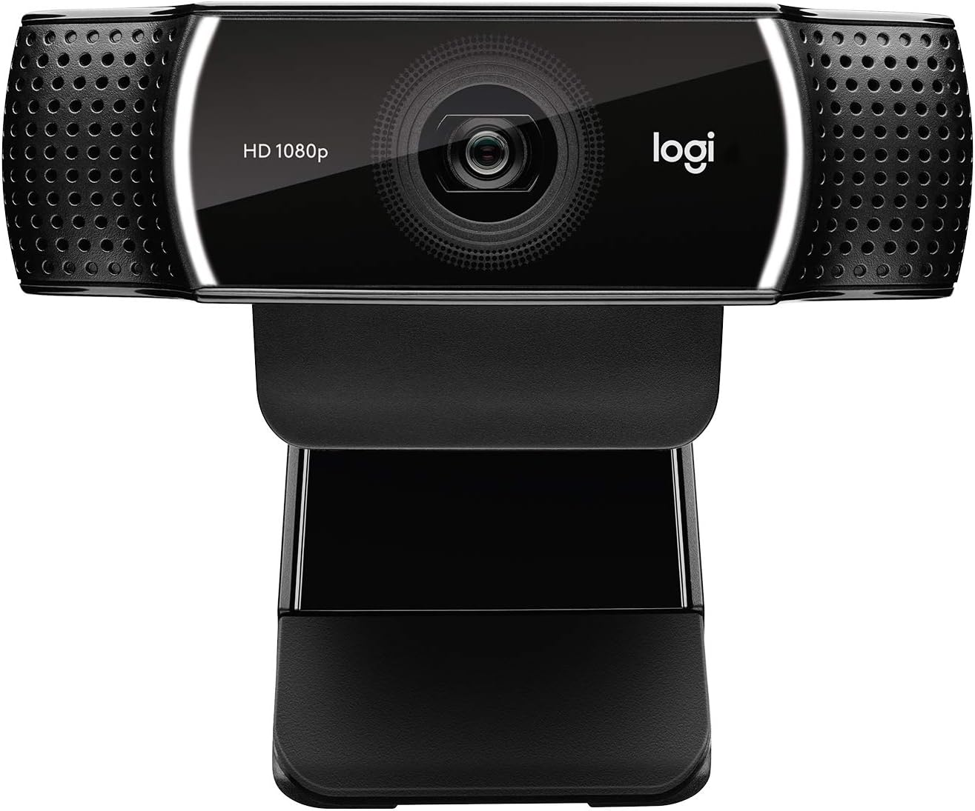
Camera Specifications
Name: Logitech C922x Pro Stream Webcam
Maximum Resolution: 1920×1080
Maximum Framerate: 30 fps (@ 1080p)
Source: Logitech C922x, Amazon.com

Slide 13
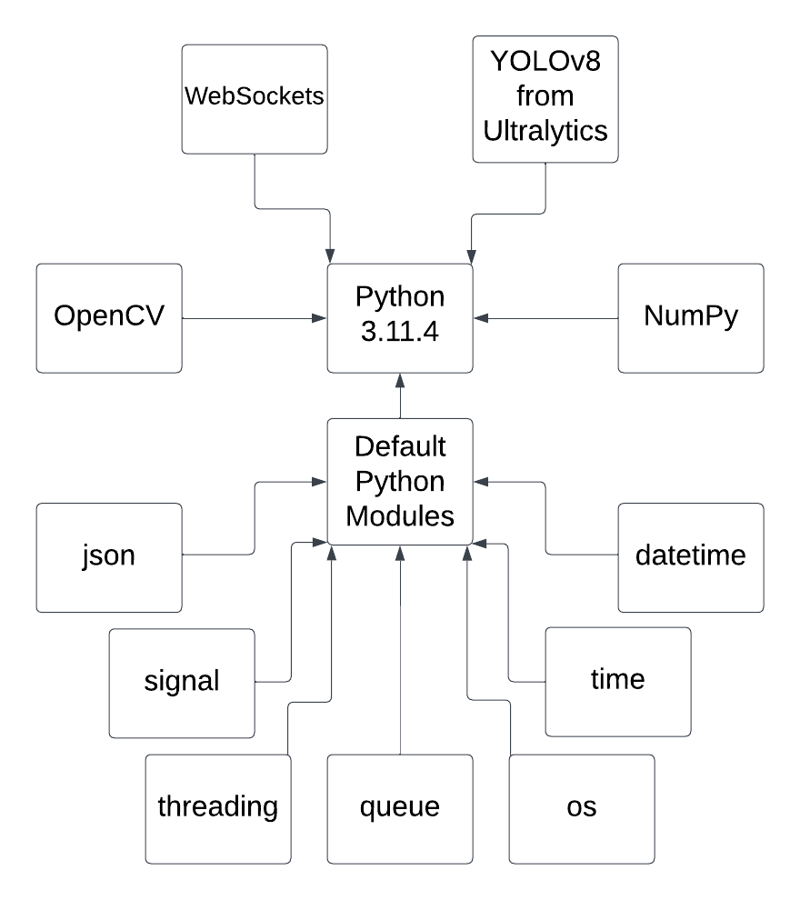
Server Programming Language and Libraries

Slide 14
The Design of the Server and the Car
The Server sends commands and operates the Car(s)
The Car(s) receive commands and drive automatically
Using websockets, the Server and the Car(s) are able to communicate with each other

Slide 15
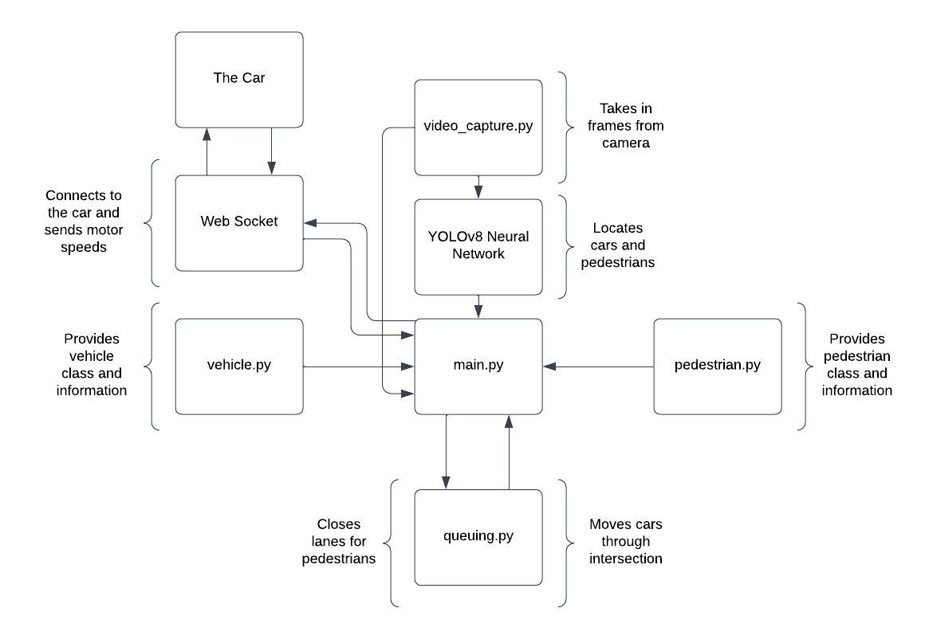
Server Design

Slide 16
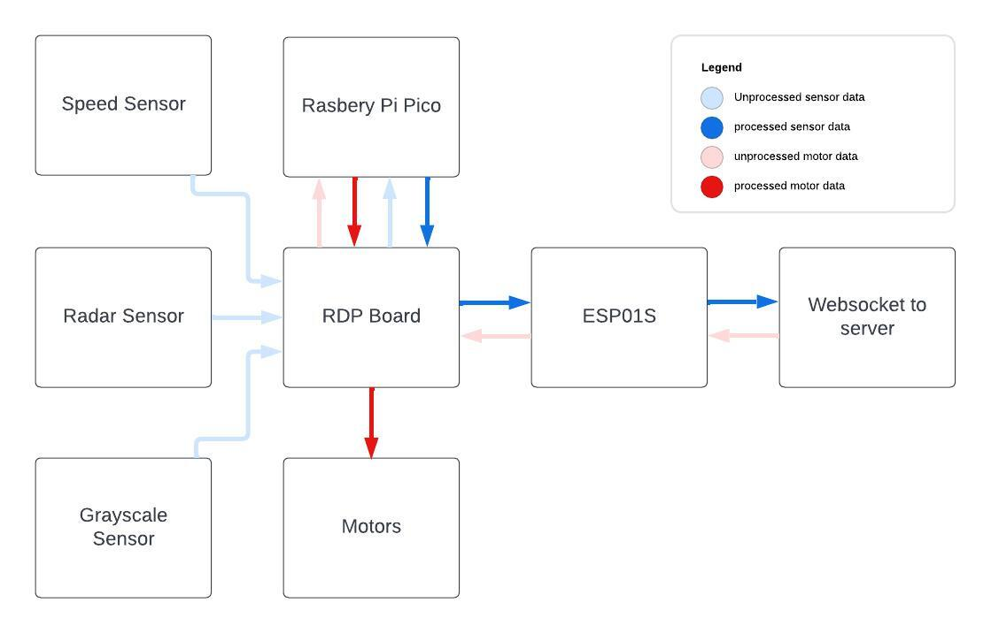
Car Design

Slide 17
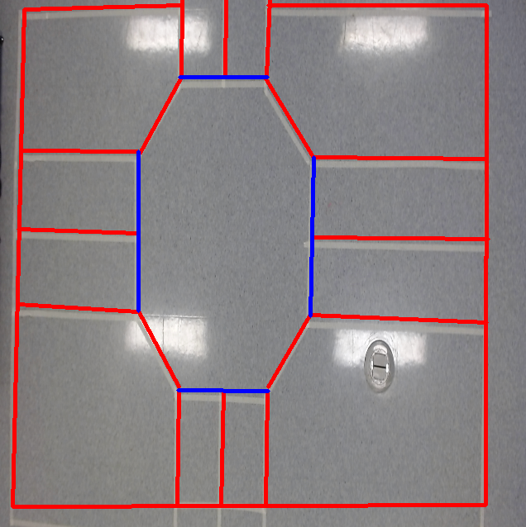
Re-creation of an Intersection Scene
Red lines represent the lanes and
border
Blue lines represent the stop lines
These lines drawn over the image assist with lane detection and the queuing process

Slide 18

What is YOLOv8
YOLO (You Only Look Once) is a popular Computer Vision Neural Network for detecting images in real-time frames
We have employed a data labelling tool, Roboflow, to annotate images and then train a YOLOv8 model in a form of “transfer learning”
Source: Ultralytics YOLOv8, linkedin.com

Slide 19
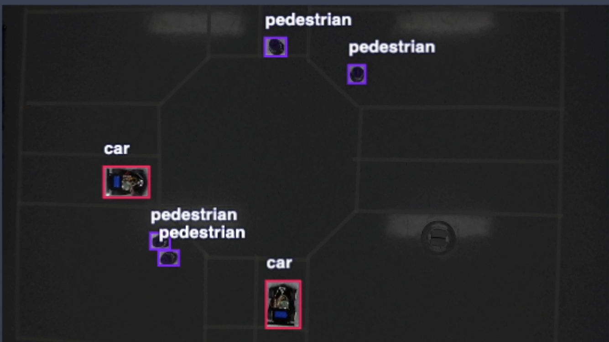
Proposed YOLOv8 Model
Trained Epochs: 53
Total Images: 29
Training images: 18 (62%)
Testing images: 5 (17%)
Validation: 6 (21%)
mAP50: 99.5%
mAP50-95 Total: 73.3%
Car: 85.3%
Pedestrian: 61.3%
Source: Roboflow

Slide 20
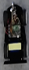
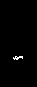
Car Identification
To identify specific cars, the server uses color-based identification
The server identifies each car by matching it to a unique color on a piece of paper, detecting the presence of this specified color based
Image of car based on bounding box location
White pixels mean the color has been detected at these locations

Slide 21
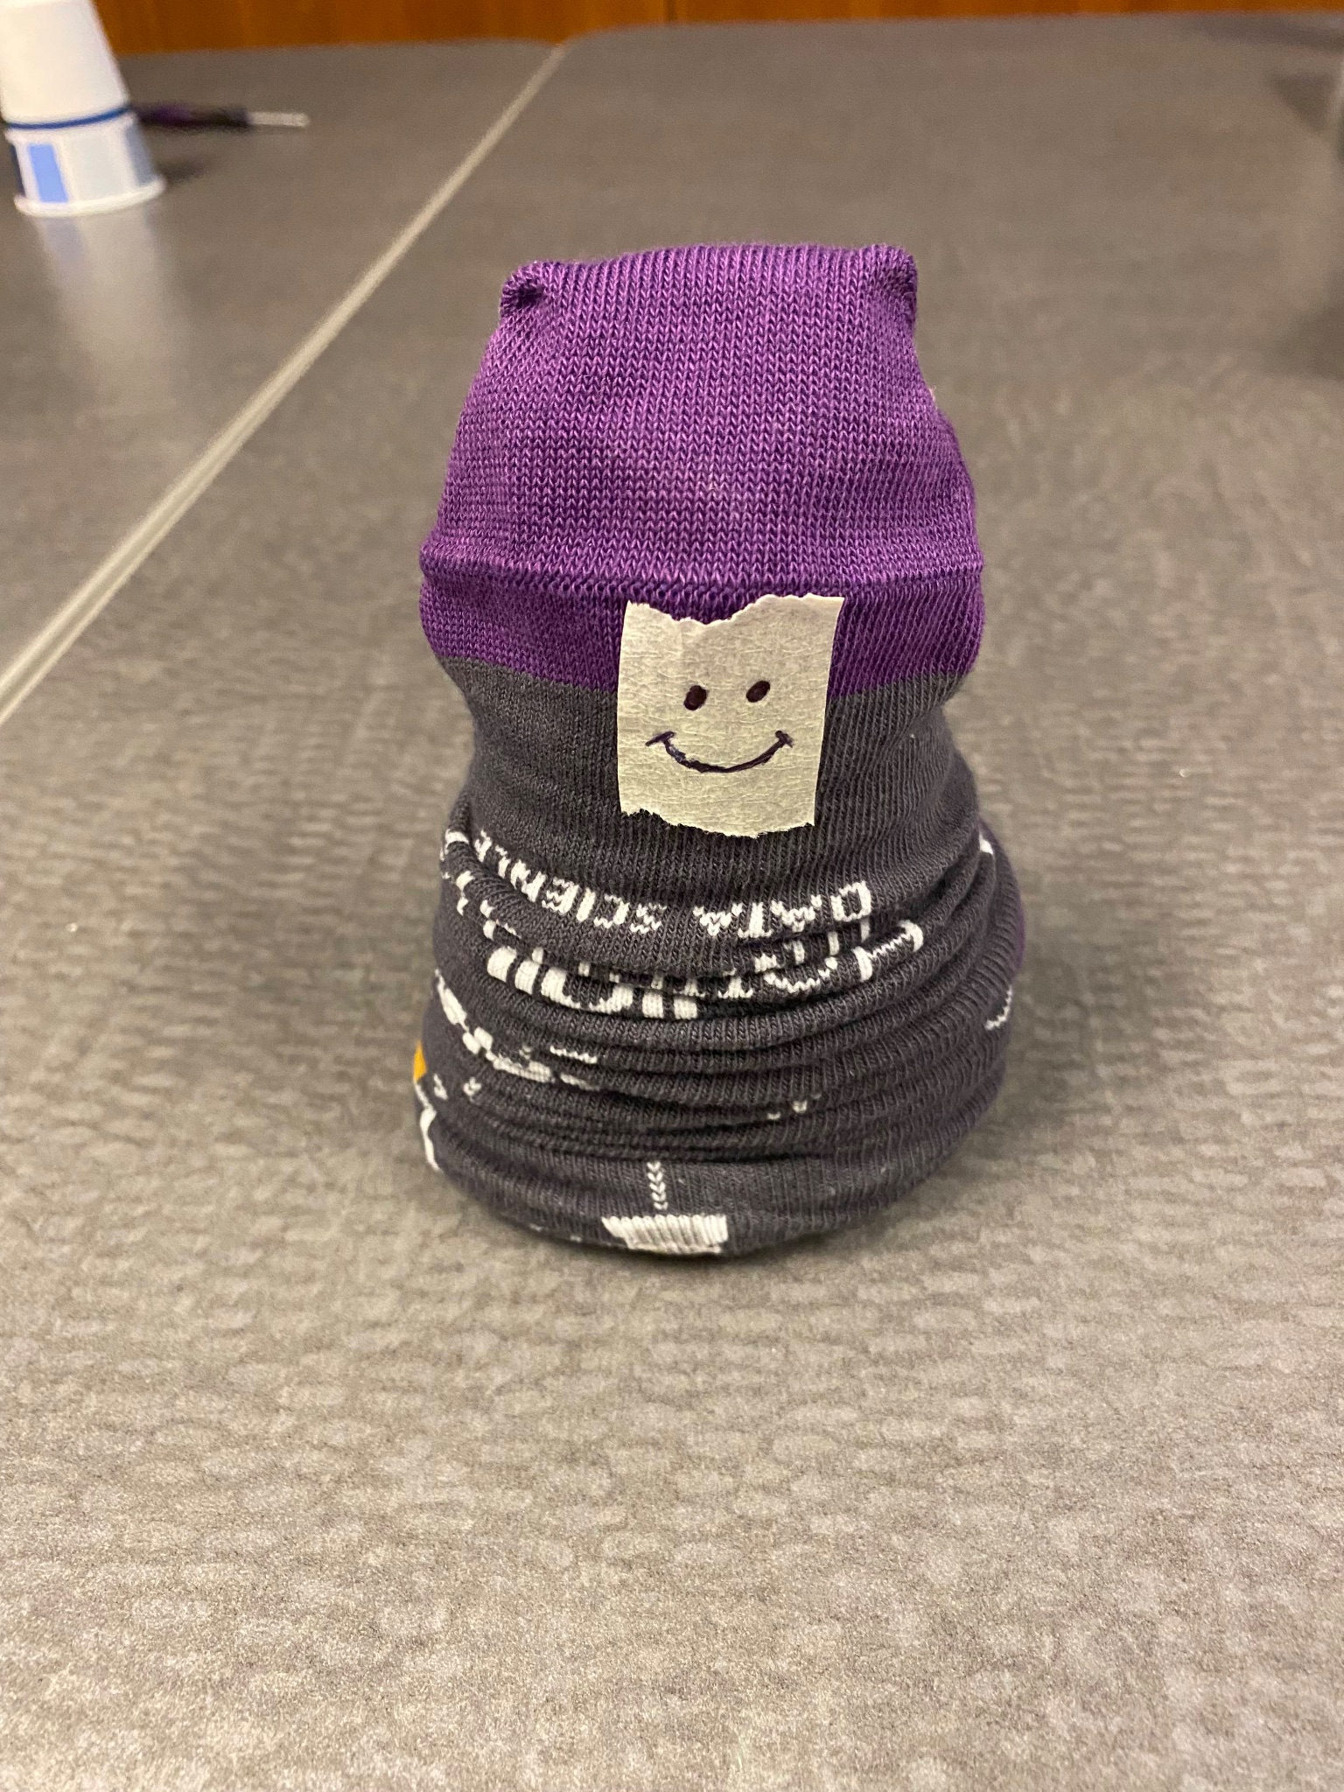
Queuing System
The queuing system has been developed for keeping track of the order of traffic
For example, if a pedestrian wants to cross the road, the traffic timing will be allocated
The queuing system will shut down the required lane for the pedestrian, keeping all other lanes open
This will bring more efficiency to crowded intersections because cars will spend less time waiting

Slide 22
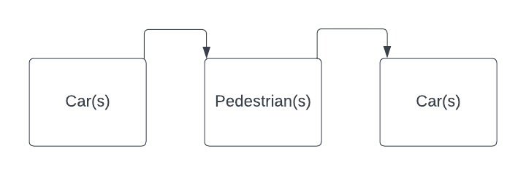
Queuing System Pseudocode
When an object is noticed by the camera:
add to the queue;
While first item in queue is a Pedestrian:
Close down lane that the Pedestrian needs for 15 seconds;
Remove pedestrian from the queue;
Iterate through items in queue:
If item is a car:
If the lane is open: Car moves;
Else: Car doesn’t move;

Slide 23
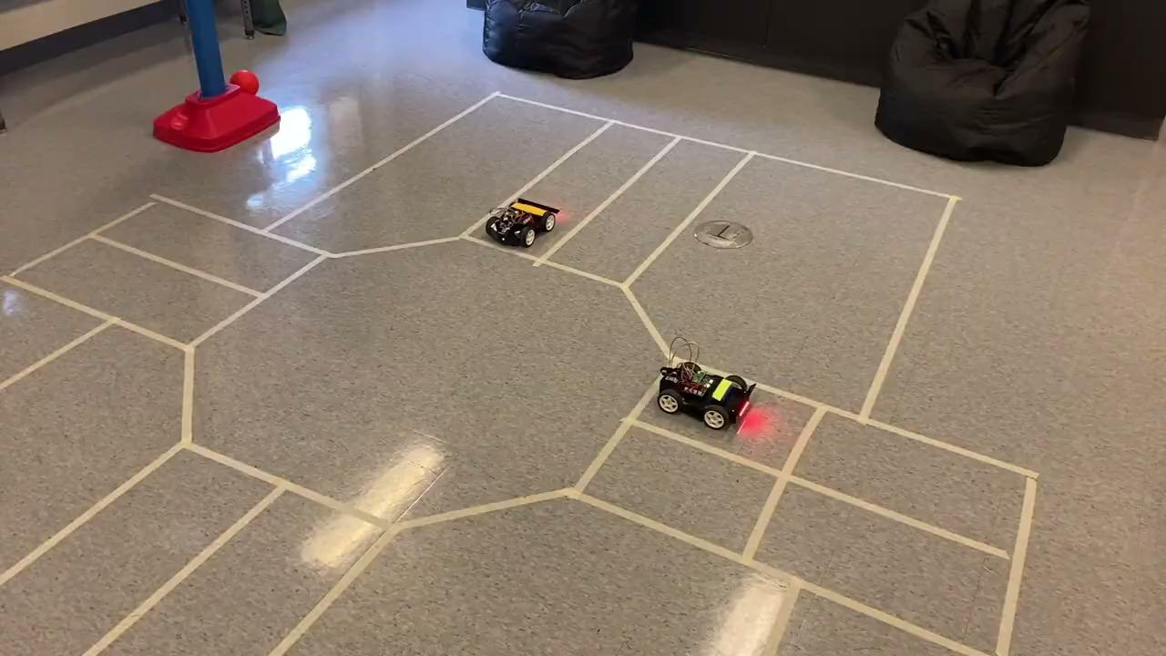
Demo: Multiple Cars Turning

Slide 24
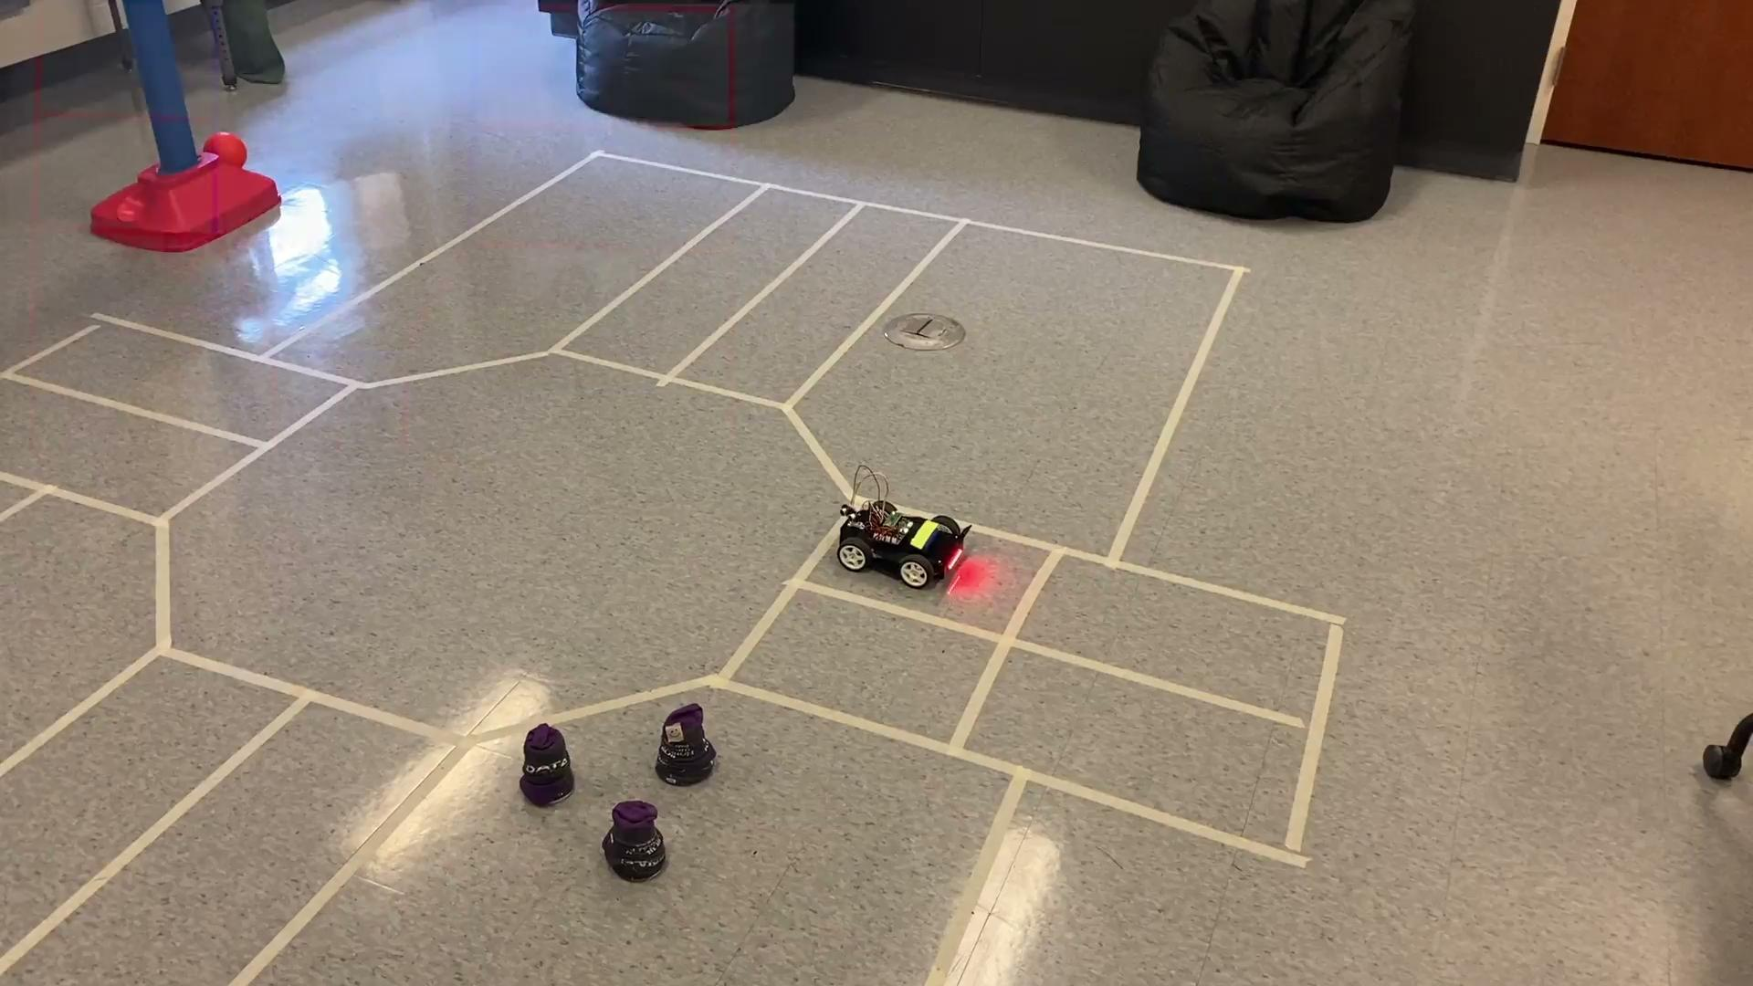
Demo: Car Waiting For Pedestrians

Slide 25
Research Outcome
Based on the testing results, we believe that the automatic intersection we designed would be feasible at a larger scale in the future.

Slide 26
Future Research
Implementation of real-world vehicles in a simulation
Developing a more robust driving system
Responding to obstacles
Training a larger and more robust object detection model
Creating a robust real-world car identification system
Running a model of both autonomous and manual vehicles at an intersection
Using LiDAR along with a camera to avoid identification issues caused by lighting or weather

